Slide 1
Adding Marina and Boat Ramp data to QGIS and Postgres
By Kody Miller
For CS540 – Professor Lehr
Spring 2021

Slide 2
First, download the required files:
https://github.com/Kodyth/CS540
Read the readme to learn more about each of the files in the repository.
The files needed to get the data in Postgres and QGIS are:
boatramps.zip
marinas.zip
Marina_and_boatramps_distance.csv

Slide 3
Create new layers in QGIS to visualize the location of each Marina/Boat ramp
Extract the .zip files into a known location such as C:\temp\cs540\qgis
In QGIS, add two new layers for the marinas and boatramps
Select layer -> add layer -> new vector layer -> from file
Select marinas.shp to create the marinas layer
Select BoatRamps.shp to create the boatramp layer
Edit the name of the boatramps layer to remove capitals letters: (BoatRamps -> boatramps)

Slide 4
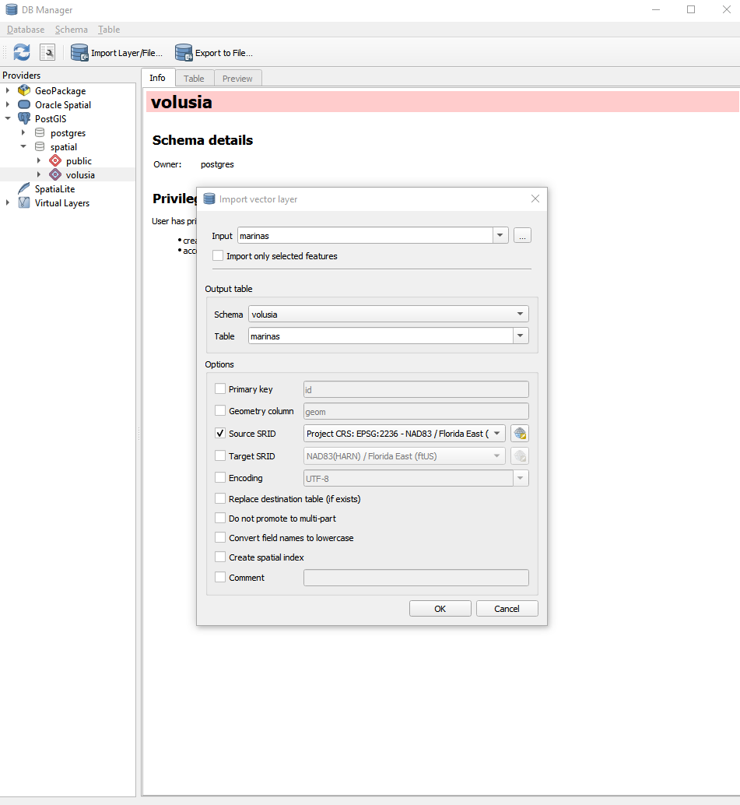
Import the marinas and boatramps layers into Postgres
Select DB Manager -> Postgis -> spatial -> volusia
Next select import layer/file
For input, select the marinas layer (repeat this process to add the boatramps layer second)
For schema select volusia
For table, select marinas
Make sure the Source SRID is the correct one for the project (EPSG:2236)
Click done and QGIS will import the layer into Postgres as a new table

Slide 5
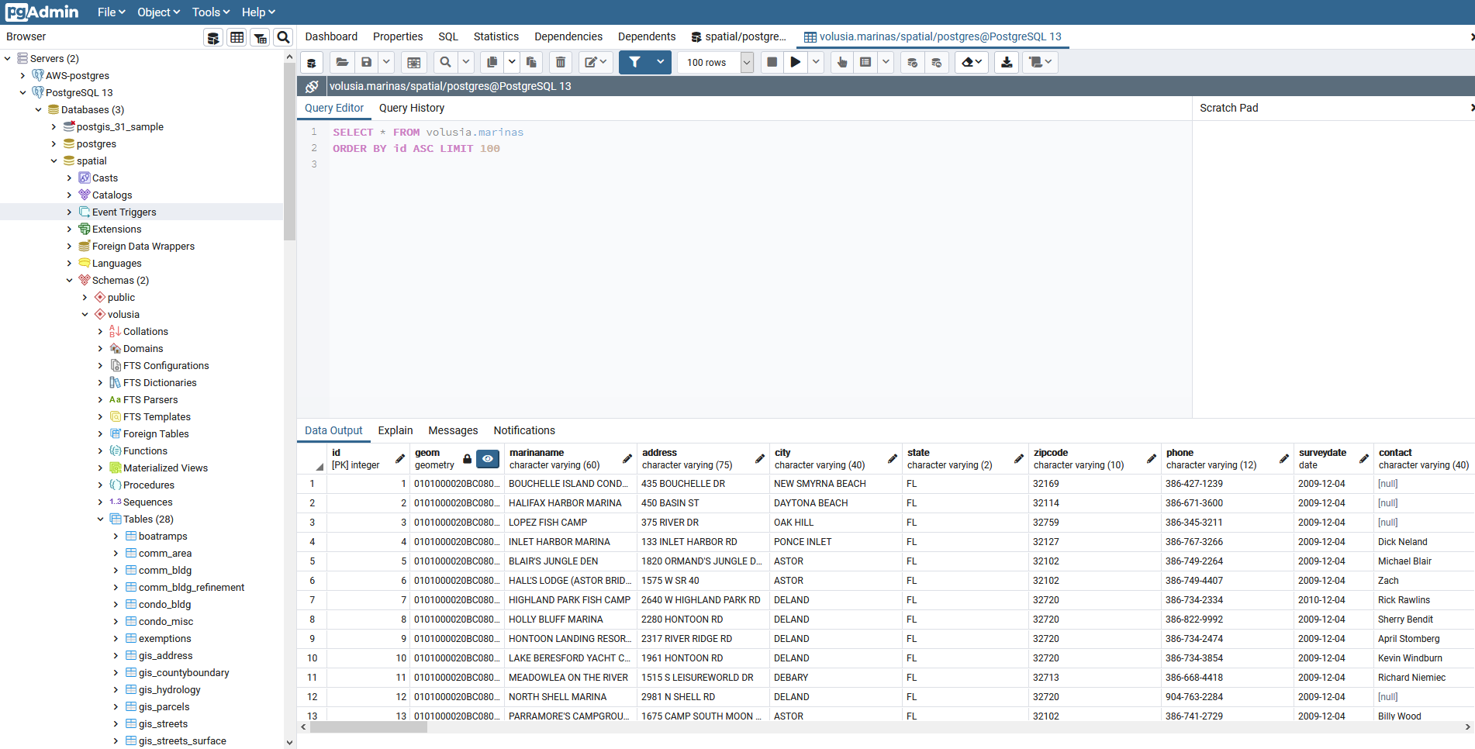
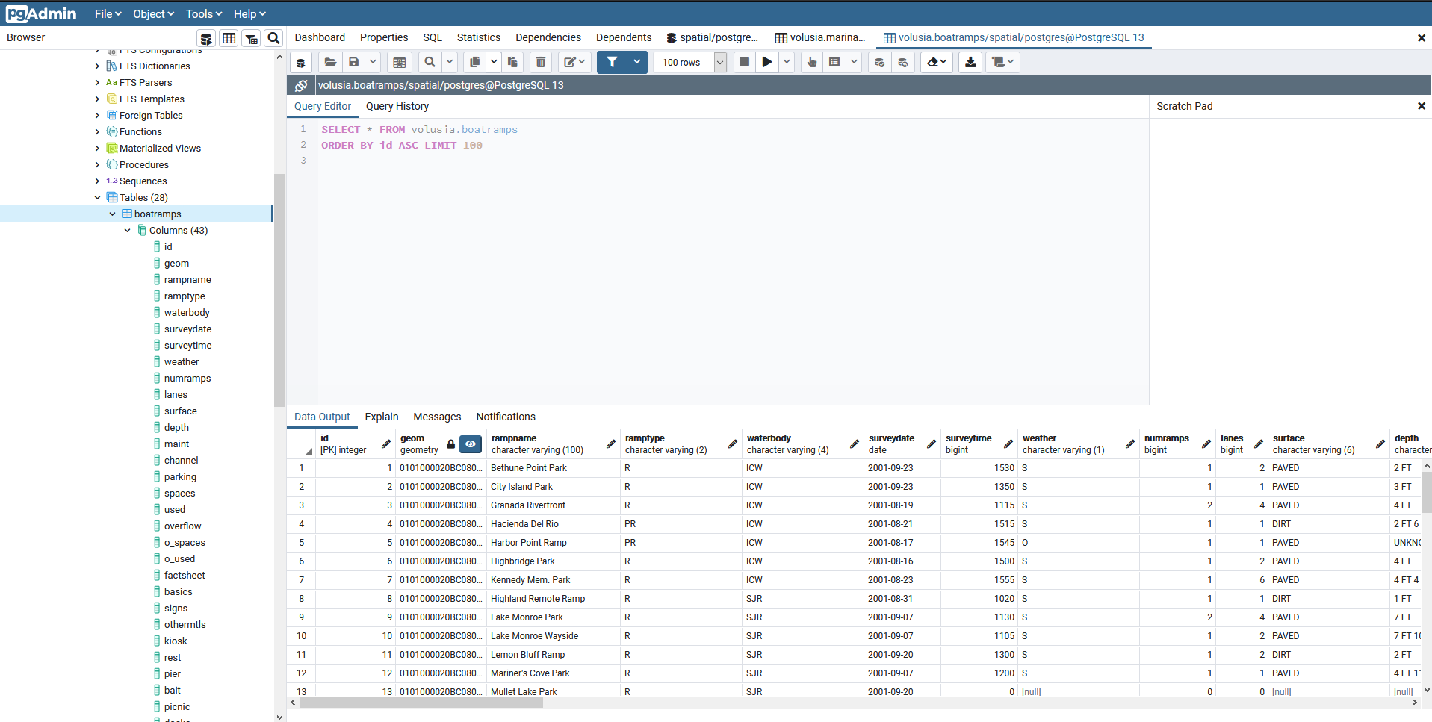
Verify tables have been added successfully
Check in PGAdmin that the tables have been created and contain data
Find each table by clicking databases -> spatial -> schema -> volusia -> tables -> marinas and boatramps
It is recommended that you change the column labeled “name” to “marinaname” in the marinas table to prevent issues when querying the table
To do this, simply right click on the name column, select properties, change the name, and click save

Slide 6

Create a new table in PGAdmin to import the distance data
Create a new table using the below command in PGAdmin using the query tool; this table will be used to import the data into the other tables

Slide 7
Import the data into the newly created table
Right click on the new table and select Import/Export
Make sure Import is selected
Choose the “marina_and_boatramp_distances.csv” file for the filename
The format is csv
Under Miscellaneous, select YES for header
Select OK and the data will be imported into the table
Verify this is the case by viewing at least the first 100 rows of the table

Slide 8
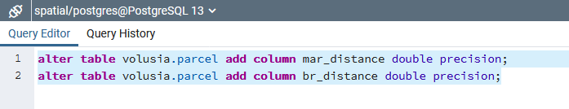
Prepare the desired table for data insertion
You can now begin the processing of merging the data into any other table such as the volusia.parcel table.
First alter the desired table to add the new columns for the distance data:
mar_distance
br_distance

Slide 9
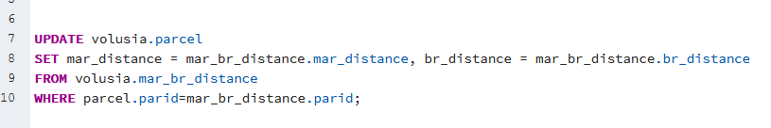
Merge the data into the desired tables
You can now merge the data into the volusia.parcel table by using the below command:
After doing that, once again check that the table has been updated correctly

Slide 10
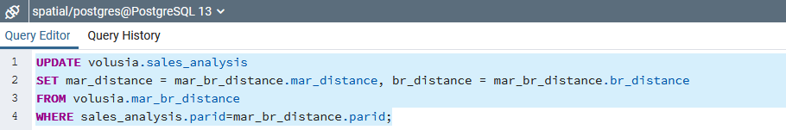
Wrapping up
At this point, the volusia.parcel table should now contain the distance data a parcel is to the closest Marina and Boat Ramp in miles.
You can also add the data to the volusia.sales_analysis table by adding the necessary columns (mar_distance, br_distance) and running the below query
To verify all the distances have been placed correctly, you can measure the distance a parcel is from the nearest marina or boat ramp in QGIS using the distance tool

